Slide 1
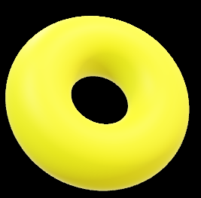
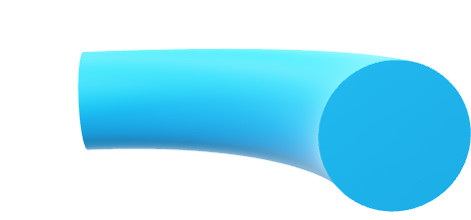


Comparative Analysis of Human Activity Recognition Using Different Versions of Yolo
-By
Om Subrato Dey
Priyam Choudhary
Devarya Lakhanpal

Slide 2


Introduction:
Human Activity Recognition (HAR):
Definition and importance of HAR in various fields (e.g., security, health
monitoring).
Overview of YOLO (You Only Look Once) models for object detection and
how they apply to HAR.
Objective:
To compare the effectiveness of different YOLO versions in recognizing and
analyzing human activities.

Slide 3
Dataset Customization:
Dataset Preparation:
->Description of the dataset used for HAR (manually labeled images)
.
Customizing the Dataset:
  Explanation of how the dataset was tailored for YOLO models.
  Labeling Process: (Using makesense.ai or Roboflow)
    Use of bounding boxes to mark activities.
    Conversion of labels into a format compatible with YOLO.
Visual Example:
Include an image showing the labeling process and bounding box application.
HAR Dataset to be modified : https://www.kaggle.com/datasets/meetnagadia/human-action-recognition-har-dataset

Slide 4
First Layer: Yolo Model Implementation
YOLO Versions:
Brief overview of the YOLO versions used (e.g., YOLOv3, YOLOv4, YOLOv5).
Model Architecture:
Explanation of how the YOLO model processes input data (image/video) to detect human activities.
First Layer:
  Describe the initial detection of human activities using YOLO.
  Highlight the differences in detection accuracy and speed among different YOLO versions.
Results:
Comparative chart or table showing performance metrics (e.g., mAP, FPS) for each YOLO version.

Slide 5
Second Layer - Algorithm for Relative Motion (Only for V5 version)
Relative Motion Analysis:
  Objective: To analyze the movement of detected human activities over time.
  Bounding Box Coordinates:
    How bounding box coordinates are used to track movement.
    Example: Tracking a person walking across a frame.
  Mathematical Equations:
    Introduction to the equations used to calculate relative motion (e.g., velocity, acceleration).
    Equation Breakdown:
      Show formulas and explain each term (e.g., change in x, y coordinates over time).
Visual Example:
  Diagram showing how bounding box coordinates change as the person moves.

Slide 6
Integration and Analysis:
Combining YOLO and Motion Analysis:
Explanation of how the first and second layers work together.
Workflow:
  YOLO detects human activities.
  The algorithm analyzes relative motion to classify and understand the
  activities.
Case Study/Example:
Walk through an example scenario (e.g., identifying and tracking a person
running in a crowded area).

Slide 7
Outcomes and Comparative Analysis:
Performance Comparison:
Summarize the findings of using different YOLO versions for HAR.
Metrics:
  Compare detection accuracy, speed, and effectiveness in recognizing
  complex activities.
Relative Motion Analysis:
  How well the motion analysis algorithm performed in conjunction with YOLO.
Challenges and Insights:
Discuss any difficulties encountered (e.g., handling occlusions, varying
lighting conditions).
Key takeaways from the comparative analysis.

Slide 8
Conclusion:
Summary:
Recap the key points of the project, including the dataset customization,
YOLO implementation, and motion analysis.
Future Work:
Potential improvements (e.g., using more advanced YOLO models, refining
motion analysis).
Applications of the research in real-world scenarios.
Acknowledgments and Questions:
Thank your audience and open the floor for questions.

